Slide 1

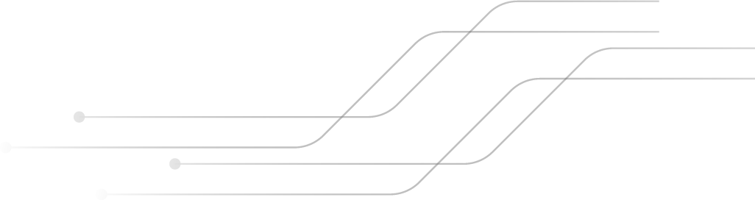

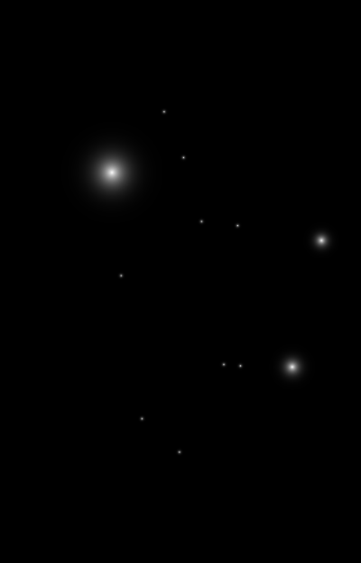
BUILDING A SMARTER AI POWERED SPAM CLASSIFIER
TEAM MEMBERS ARE :
G.GANESH GOPAL (821021104019)
S.ABDURRAZZAK (821021104004)
K.SRI RAM (821021104044)
B.GANESAN (821021104302)
K SIVA PRAKASH (821021104305)

Slide 2
INTRODUCTION
A spam classifier is a crucial tool designed to automatically discern legitimate messages from spam and, in doing so, enhance the efficiency and security of our digital communication. This introduction to spam classification will delve into the underlying concepts, methodologies, and the significance of spam classifiers in the modern digital landscape. Spam classification employs various techniques from the realm of artificial intelligence and machine learning, leveraging pattern recognition and data analysis to categorize incoming messages.

Slide 3
DEFINITON OF SPAM CLASSIFIER
A spam classifier, also known as a spam filter, is a software or machine learning system designed to automatically categorize and separate incoming messages, such as emails, text messages, or comments, into two primary categories: "spam" and "non-spam" (often referred to as "ham")
The main purpose of a spam classifier is to identify and filter out unsolicited and unwanted messages, often characterized by their potential to be deceptivee, irrelevant, or harmful to the recipient.
They are an essential component of email systems, messaging apps, and other digital communication platforms, helping users focus on legitimate and relevant messages while minimizing the disruption caused by spam.

Slide 4
Data source DATA LINK : https://www.kaggle.com/datasets/uciml/sms-spam-collection-dataset packages : Python. Scikit-Learn. Natural Language Toolkit (NLTK). pandas. NumPy. TensorFlow or PyTorch. XGBoost, LightGBM, or CatBoost. TextBlob or spaCy. Matplotlib and Seaborn. Jupyter Notebooks. Sklearn-extensions. Flask or Django.

Slide 5
INNOVATIVE TECHNIQUES AND APPROACHES : Machine Learning and Deep Learning: The use of machine learning algorithms, particularly deep learning models like neural networks, has greatly improved spam classification accuracy. These models can automatically learn complex patterns and features in the data, making them adaptable to new spam tactics. Natural Language Processing (NLP): NLP techniques enable spam classifiers to analyze the text content of messages, identifying language patterns, sentiment, and context. This is especially useful in distinguishing between legitimate messages and spam with content designed to deceive. Behavioral Analysis: Some advanced spam classifiers monitor user behavior and interactions with messages. By observing how users interact with their email or messages, classifiers can detect anomalies and identify potential spam based on deviations from typical behavior.

Slide 6
Anomaly Detection: Anomaly detection techniques are applied to identify unusual patterns in messages. These anomalies can be indicative of spam, especially when spammers use unconventional tactics that differ from typical communication patterns. Feature Engineering: Feature engineering involves designing and selecting relevant attributes or features from the data. Innovative feature engineering can improve the accuracy of spam classification by incorporating new attributes and signals from messages. Ensemble Methods: Combining multiple spam classifiers using ensemble methods, such as bagging, boosting, or stacking, can lead to improved classification performance. This approach harnesses the strength of multiple models to make more accurate predictions.

Slide 7
Semi-Supervised Learning: Combining labeled data with a large amount of unlabeled data allows classifiers to learn from both supervised and unsupervised techniques, which can be especially valuable in cases where obtaining labeled training data is challenging. Adaptive Learning: An adaptive spam classifier continually updates its models and rules to respond to emerging spam techniques. This real-time adaptation helps classifiers stay effective as spammers develop new strategies. User Feedback Integration: Incorporating user feedback and preferences can enhance spam classification. When users mark messages as spam or not spam, these signals can be used to train and fine-tune the classifier.

Slide 8
Explainable AI: Innovations in creating interpretable models allow users and administrators to understand why a particular message was classified as spam. This transparency is important for trust and accountability in spam classification systems. Cross-Platform Integration: As spammers target various digital communication platforms, including email, social media, and messaging apps, innovative spam classifiers are designed to work across these platforms, ensuring consistent protection. Ethical Considerations: With innovation comes responsibility. Ethical considerations in spam classification involve striking a balance between spam prevention and preserving users' privacy and freedom of communication.

Slide 9



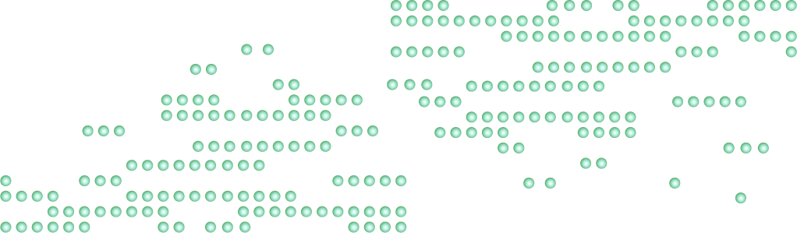
PROGRAMS FOR SPAM CLASSIFIER
import numpy as np
import pandas as pd
import os
for dirname, _, filenames in os.walk('/kaggle/input'):
for filename in filenames:
print(os.path.join(dirname, filename))
sms = pd.read_csv("/kaggle/input/sms-spam-collection-dataset/spam.csv", encoding = "ISO-8859-1", usecols=[0,1], skiprows=1,names=["label", "message"])
sms.head()
sms.label = sms.label.map({"ham":0, "spam":1})
sms.label.value_counts()
from sklearn.model_selection import train_test_split
features_train, features_test, labels_train, labels_test = train_test_split(sms.message,sms.label,test_size=0.2)

Slide 10
from sklearn.feature_extraction.text import CountVectorizer couvec = CountVectorizer() couvec.fit(features_train) trained_features = couvec.get_feature_names() print("Número de características vetorizadas:", len(trained_features)) print("Exemplos de características treinadas:",trained_features[1:10]) dtm_train = couvec.fit_transform(features_train) print("Shape of dtm_train:", dtm_train.shape) print(dtm_train[0:2]) dtm_test = couvec.transform(features_test) print("Shape of dtm_test:", dtm_test.shape) from sklearn.naive_bayes import MultinomialNB nb = MultinomialNB() nb.fit(dtm_train, labels_train) labels_pred = nb.predict(dtm_test) from sklearn import metrics metrics.accuracy_score(labels_test, labels_pred) metrics.confusion_matrix(labels_test, labels_pred) print("Recall:", metrics.recall_score(labels_test, labels_pred)) print("Precisão:", metrics.precision_score(labels_test, labels_pred)) print("Ordem das classes no predict_proba:", nb.classes_) print("Exemplos de probabilidades de classes:", nb.predict_proba(dtm_test)[0]) labels_prob = nb.predict_proba(dtm_test)[:, 1] precisions, recalls, thresholds = metrics.precision_recall_curve(labels_test, labels_prob)

Slide 11
from sklearn import metrics metrics.accuracy_score(labels_test, labels_pred) metrics.confusion_matrix(labels_test, labels_pred) print("Recall:", metrics.recall_score(labels_test, labels_pred)) print("Precisão:", metrics.precision_score(labels_test, labels_pred)) print("Ordem das classes no predict_proba:", rf.classes_) print("Exemplos de probabilidades de classes:", rf.predict_proba(dtm_test)[0]) labels_prob = rf.predict_proba(dtm_test)[:, 1] precisions, recalls, thresholds = metrics.precision_recall_curve(labels_test, labels_prob) import matplotlib.pyplot as plt plt.figure(figsize=(10, 7)) plt.plot(precisions[:-1], recalls[:-1]) plt.xlabel("Recalls") plt.ylabel("Precisão") plt.title("Curva Precisão-Recall") plt.show()

Slide 12
OUTPUT
Shape of dtm_train:(4457, 7742)
(0, 3537) 1
(0, 6785) 1
(0, 5169) 1
(0, 6480) 1
(1, 1440) 1
(1, 4940) 1
(1, 4675) 2
(1, 7385) 1
(1, 6908) 1
(1, 4581) 1
(1, 6044) 1
(1, 4337) 1
(1, 6959) 1
(1, 6315) 1
(1, 7702) 1

Slide 13
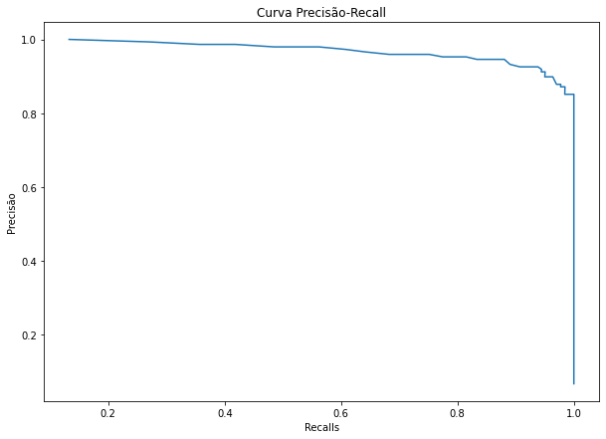
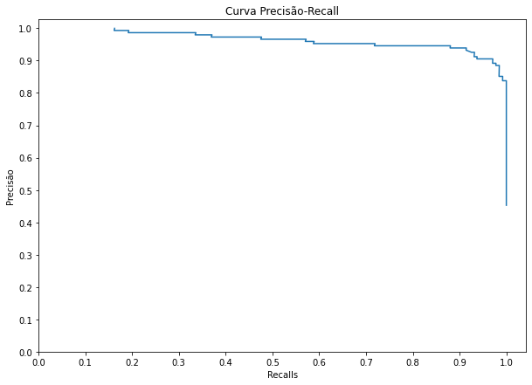
CHART OUTPUT 1 OUTPUT 2

Slide 14
CONCLUSION
Building A Smarter Ai-powered Spam Classifier Is A Multifaceted Endeavor That Requires A Combination Of Data, Feature Engineering, Machine Learning Techniques, And Vigilant Model Monitoring. As Technology Evolves And Spammers Adapt Their Tactics, It Is Imperative To Remain Agile And Responsive. By Doing So, We Can Create And Maintain Spam Classifiers That Not Only Protect Users From Unwanted And Potentially Harmful Content But Also Contribute To A Safer And More Productive Digital Environment. This Undertaking Remains A Continuous Effort, Where Advancements In AI And Machine Learning Will Play A Pivotal Role In Staying One Step Ahead Of Spam.

